Slide 1
Virtual Memory
Background
Demand Paging
Process Creation
Page Replacement
Allocation of Frames
Thrashing
Operating System Examples
Operating System Concepts

Slide 2
Background
Virtual memory – separation of user logical memory from physical memory.
  Only part of the program needs to be in memory for execution.
  Logical address space can therefore be much larger than physical address space.
  Allows address spaces to be shared by several processes.
  Allows for more efficient process creation.
Virtual memory can be implemented via:
  Demand paging
  Demand segmentation
Operating System Concepts

Slide 3
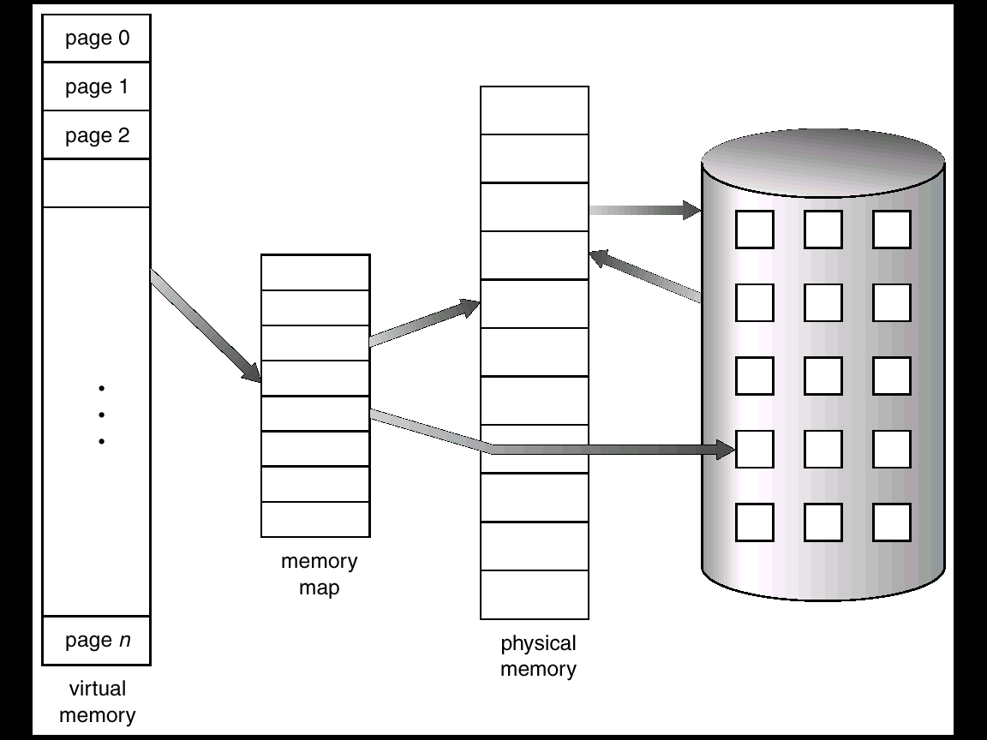
Virtual Memory That is Larger Than Physical Memory
Operating System Concepts

Slide 4
Demand Paging
Bring a page into memory only when it is needed.
  Less I/O needed
  Less memory needed
  Faster response
  More users
Page is needed ⇒ reference to it
  invalid reference ⇒ abort
  not-in-memory ⇒ bring to memory
Operating System Concepts

Slide 5
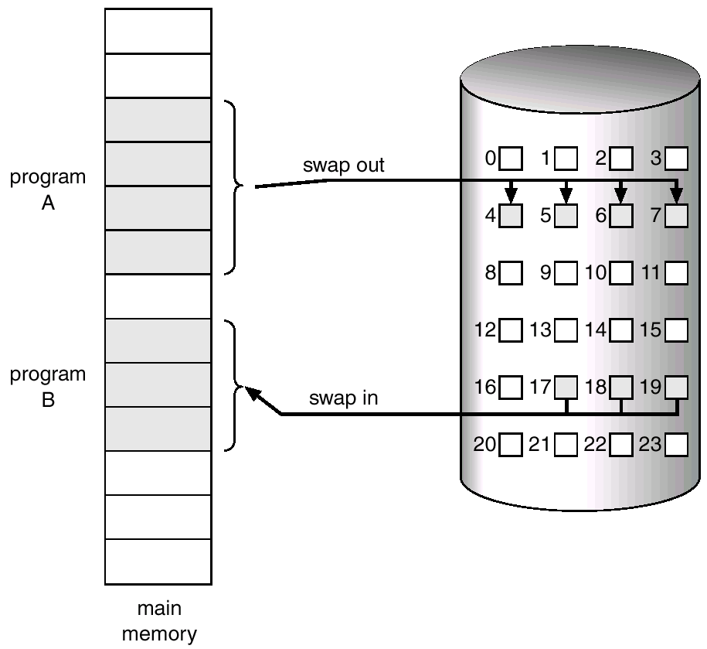
Transfer of a Paged Memory to Contiguous Disk Space
Operating System Concepts

Slide 6
Valid-Invalid Bit
With each page table entry a valid–invalid bit is associated
(1 ⇒ in-memory, 0 ⇒ not-in-memory)
Initially valid–invalid but is set to 0 on all entries.
Example of a page table snapshot.
During address translation, if valid–invalid bit in page table entry is 0 ⇒ page fault.
Frame #
valid-invalid bit
1
1
1
1
0

0
0
page table

Slide 7

Page Table When Some Pages Are Not in Main Memory
Operating System Concepts

Slide 8
Page Fault
If there is ever a reference to a page, first reference will trap to
OS ⇒ page fault
OS looks at another table to decide:
  Invalid reference ⇒ abort.
  Just not in memory.
Get empty frame.
Swap page into frame.
Reset tables, validation bit = 1.
Restart instruction: Least Recently Used
  block move
  auto increment/decrement location
Operating System Concepts

Slide 9

Steps in Handling a Page Fault
Operating System Concepts

Slide 10
What happens if there is no free frame?
Page replacement – find some page in memory, but not really in use, swap it out.
  algorithm
  performance – want an algorithm which will result in minimum number of page faults.
Same page may be brought into memory several times.
Operating System Concepts

Slide 11
Page Replacement
Prevent over-allocation of memory by modifying page-fault service routine to include page replacement.
Use modify (dirty) bit to reduce overhead of page transfers – only modified pages are written to disk.
Page replacement completes separation between logical memory and physical memory – large virtual memory can be provided on a smaller physical memory.
Operating System Concepts

Slide 12
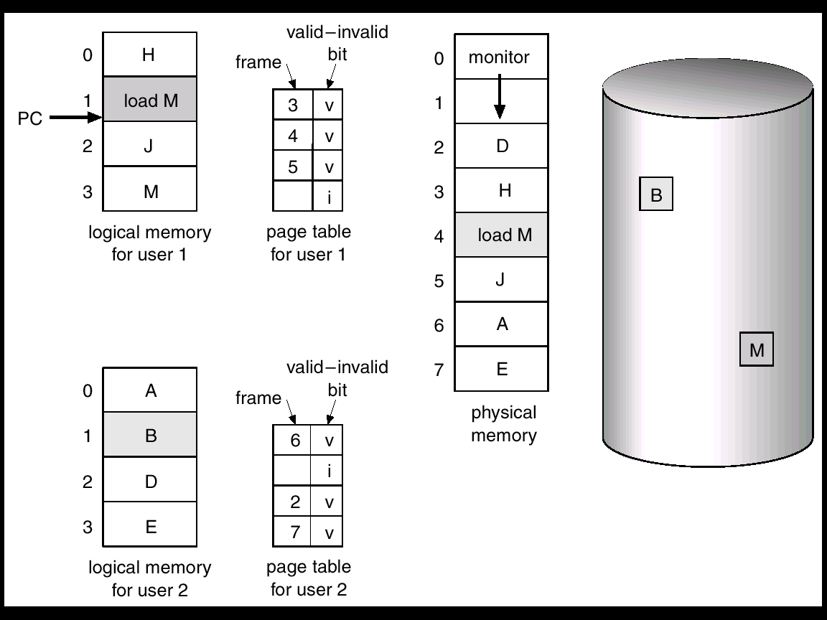
Need For Page Replacement
Operating System Concepts

Slide 13
Basic Page Replacement
Find the location of the desired page on disk.
Find a free frame:
- If there is a free frame, use it.
- If there is no free frame, use a page replacement algorithm to select a victim frame.
Read the desired page into the (newly) free frame. Update the page and frame tables.
Restart the process.
Operating System Concepts

Slide 14

Page Replacement
Operating System Concepts

Slide 15
Page Replacement Algorithms
Want lowest page-fault rate.
Evaluate algorithm by running it on a particular string of memory references (reference string) and computing the number of page faults on that string.
In all our examples, the reference string is
1, 2, 3, 4, 1, 2, 5, 1, 2, 3, 4, 5.
Operating System Concepts

Slide 16

Graph of Page Faults Versus The Number of Frames
Operating System Concepts

Slide 17
First-In-First-Out (FIFO) Algorithm
Reference string: 1, 2, 3, 4, 1, 2, 5, 1, 2, 3, 4, 5
Replace the page which is the oldest one
3 frames (3 pages can be in memory at a time per process)
4 frames
FIFO Replacement – Belady’s Anomaly
  more frames ⇒ less page faults
1
1
4
5
2
2
1
3
9 page faults
3
3
2
4
1
1
5
4
2
2
1
5
10 page faults
3
3
2
4
4
3
Operating System Concepts

Slide 18
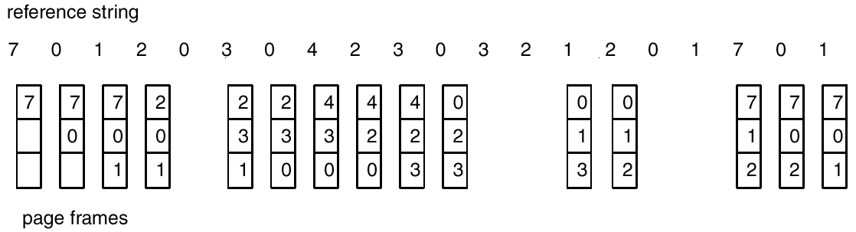
FIFO Page Replacement
Operating System Concepts

Slide 19

FIFO Illustrating Belady’s Anamoly
Operating System Concepts

Slide 20
Optimal Algorithm
Replace page that will not be used for longest period of time.
4 frames example
1, 2, 3, 4, 1, 2, 5, 1, 2, 3, 4, 5
How do you know this?
Used for measuring how well your algorithm performs.
1
4
2
6 page faults
3
4
5
Operating System Concepts

Slide 21
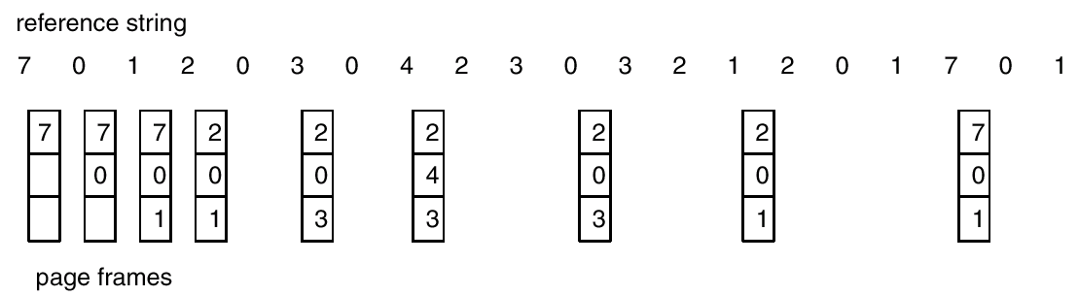
Optimal Page Replacement
Operating System Concepts

Slide 22
Least Recently Used (LRU) Algorithm
Reference string: 1, 2, 3, 4, 1, 2, 5, 1, 2, 3, 4, 5
Replace the page that has not been used for the longest period of time
Counter implementation
  Every page entry has a counter; every time page is referenced through this entry, copy the clock into the counter.
  When a page needs to be changed, look at the counters to determine which are to change.
1
5
2
3
5
4
4
3
Operating System Concepts

Slide 23
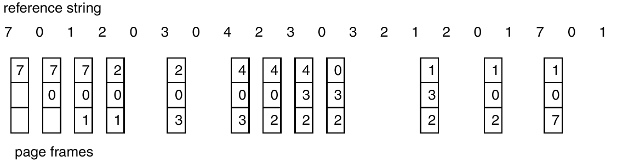
LRU Page Replacement
Operating System Concepts

Slide 24
LRU Algorithm (Cont.)
Stack implementation – keep a stack of page numbers in a double link form:
  Page referenced:
    move it to the top
    requires 6 pointers to be changed
  No search for replacement
Operating System Concepts

Slide 25
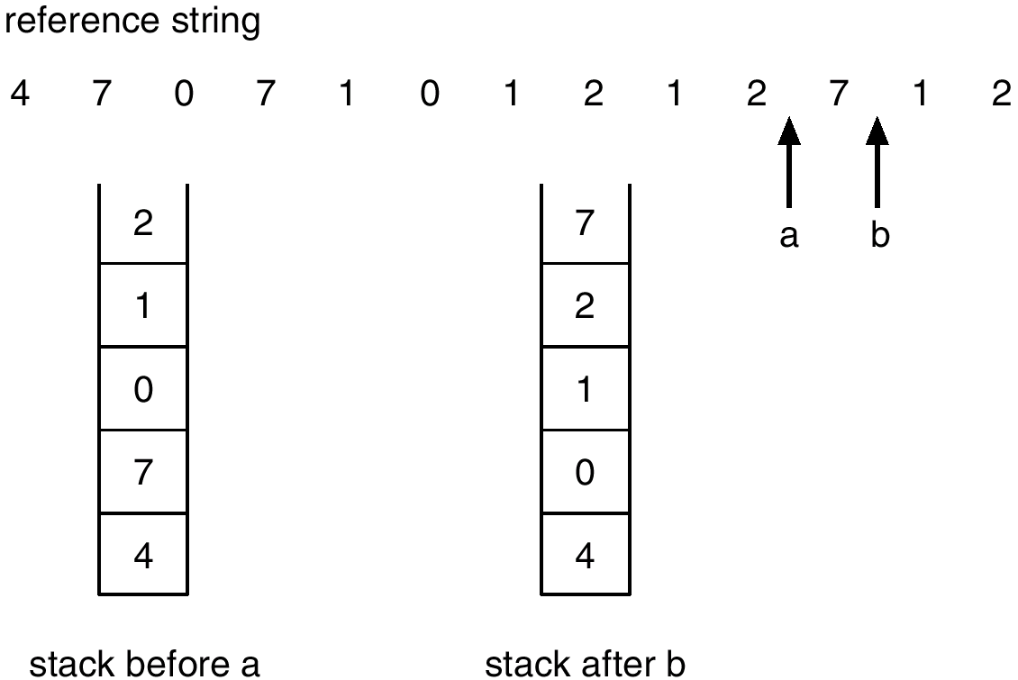
Use Of A Stack to Record The Most Recent Page References
Operating System Concepts

Slide 26
LRU Approximation Algorithms
Reference bit
  With each page associate a bit, initially = 0
  When page is referenced bit set to 1.
  Replace the one which is 0 (if one exists). We do not know the order, however.
Second chance
  Need reference bit.
  Clock replacement.
  If page to be replaced (in clock order) has reference bit = 1. then:
    set reference bit 0.
    leave page in memory.
    replace next page (in clock order), subject to same rules.
Operating System Concepts

Slide 27

Second-Chance (clock) Page-Replacement Algorithm
Operating System Concepts

Slide 28
Counting Algorithms
Keep a counter of the number of references that have been made to each page.
LFU Algorithm: replaces page with smallest count.
MFU Algorithm: based on the argument that the page with the smallest count was probably just brought in and has yet to be used.
Operating System Concepts

Slide 29
Allocation of Frames
Each process needs minimum number of pages.
Example: IBM 370 – 6 pages to handle SS MOVE instruction:
  instruction is 6 bytes, might span 2 pages.
  2 pages to handle from.
  2 pages to handle to.
Two major allocation schemes.
  fixed allocation
  priority allocation
Operating System Concepts

Slide 30


Fixed Allocation
Equal allocation – e.g., if 100 frames and 5 processes, give each 20 pages.
Proportional allocation – Allocate according to the size of process.
Operating System Concepts

Slide 31
Priority Allocation
Use a proportional allocation scheme using priorities rather than size.
If process P_{i} generates a page fault,
  select for replacement one of its frames.
  select for replacement a frame from a process with lower priority number.
Operating System Concepts

Slide 32
Global vs. Local Allocation
Global replacement – process selects a replacement frame from the set of all frames; one process can take a frame from another.
Local replacement – each process selects from only its own set of allocated frames.
Operating System Concepts

Slide 33
Thrashing
If a process does not have “enough” pages, the page-fault rate is very high. This leads to:
  low CPU utilization.
  operating system thinks that it needs to increase the degree of multiprogramming.
  another process added to the system.
Thrashing ≡ a process is busy swapping pages in and out.
Operating System Concepts

Slide 34

Thrashing
Why does paging work?
Locality model
  Process migrates from one locality to another.
  Localities may overlap.
Why does thrashing occur?
Σ size of locality > total memory size
Operating System Concepts

